Slide 1
INTRODUCTION TO ICT
Lesson 2
Representation of Data in computer
Copyright by SOICT

Slide 2
Content
  Numeral systems
  Data representation in computer
  Information unit
  Representation of integer number
  Representation of real number
  Representation of character
Copyright by SOICT

Slide 3
I. Numeral systems
Numeral system:
  Is a set of symbols and rules, using which we can represent and determine the value of numbers.
  Each numeral system uses a finite set of characters/symbols/digits. The number of characters/symbols/digits is called the base or radix of the numeral system, normally denoted by b
  E.g.: In the decimal system, we use ten digits: 0,1,2,…,9, hence b =10

Slide 4
I. Numeral systems
Mathematically, we can represent a number in any numeral system
In computer science, we usually using following counting systems:
  Decimal system
  Binary system
  Octal system
  Hexadecimal system

Slide 5
Decimal system
The decimal system (with b = 10) using 10 digits:
0, 1, 2, 3, 4, 5, 6, 7, 8, 9
In the decimal system, using n digits we can represent 10^{n} different values, ranging from 0 to 10^{n}-1:
    00...000 = 0
    ....
    99...999 = 10^{n}-1

Slide 6
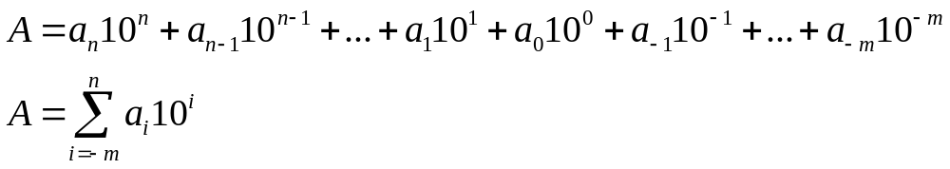
Decimal system
Supposing that a number A which is represented in the decimal system as:
  A = a_{n} a_{n-1} … a₁ a₀ . a₋₁ a₋₂ … a_{-m}
→ The value of A is determined as:

Slide 7
Decimal system
E.g. 1: The value of the number 5246 is determined as:
5246 = 5 x 10³ + 2 x 10² + 4 x 10¹ + 6 x 10⁰
E.g. 2: The value of the number 254.68 is determined as:
  254.68 = 2 x 10² + 5 x 10¹ + 4 x 10⁰ + 6 x 10⁻¹ + 8 x 10⁻²

Slide 8
b-base system
In general, a b-base numeral system (b >=2, integer):
  Using b digits, ranging from 0 to b-1
  A number N_{(b)} in the b-base numeral system is represented as:
  N_{(b)}=a_{n-1}a_{n-2…}a₁a₀.a₋₁a₋₂…a_{-m}
  In the above representation, n digits is used to represent integer part and m digits for fraction

Slide 9
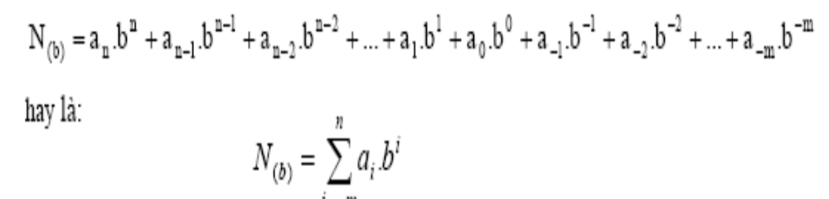
b-base system
  The value of number N_{(b)} is determined as:

Slide 10
The binary system
Base b = 2
Using 2 digits: 0 and 1
Binary digit (0 or 1) is called a bit (binary digit)
E.g.: bit 0, bit 1
Bit is the smallest information unit

Slide 11
The binary system
Using n bits we can represent 2^{n} different value, ranging from 0 to 2^{n} -1:
  00...000 (2)= 0
  ...
  11...111 (2)= 2^{n} - 1
E.g.: Using 2 bits we can represent 4 values: 00 (=0); 01 (=1); 10 (=2); 11 (=3)

Slide 12
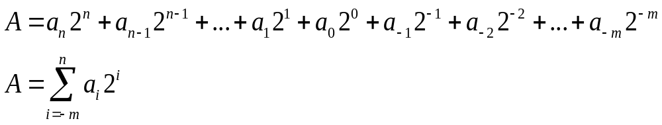
The binary system
Supposing that a number A which is represented in the binary system as:
A = a_{n} a_{n-1} … a₁ a₀ . a₋₁ a₋₂ … a_{-m}
,in which a_{i} is binary digit (0,1), then value of A is determined as:

Slide 13
The binary system
E.g.: The value of the binary number 1101001.1011 is determined as:
  1101001.1011₍₂₎ = 2⁶ + 2⁵ + 2³ + 2⁰ + 2⁻¹ + 2⁻³ + 2⁻⁴
  = 64 + 32 + 8 + 1 + 0.5 + 0.125 + 0.0625 = 105.6875₍₁₀₎

Slide 14
Plus/Minis in the binary system
Plus:
1+0=0+1=1;
0+0=0;
1+1=10;
Minus
  1-1=0;
  0-0=0;
  1-0=1;
  0-1=1; (borrow 1)

Slide 15
Example: Plus
  1 0 1
  + 1 1 1
  ---------
  11 0 0

Slide 16
Example: Minus
1 1 0 0
1 1 1
--------------------
0 1 0 1

Slide 17
The octal system
Base b = 8
Using 8 digits: 0,1,2,3,4,5,6,7
With n digits we can represent 8^{n} different values, ranging from 0 to 8^{n} -1 as:
  00...000 = 0
  ...
  77...777 = 8^{n} -1

Slide 18
The octal system
Supposing that an A number which is represented in the octal system as:
A = a_{n} a_{n-1} … a₁ a₀ . a₋₁ a₋₂ … a_{-m}
with a_{i} is digit in the octal system, then value of A is determined as:
with b = 8.

Slide 19
The octal system
E.g.: Determine the value of
235 . 64 ₍₈₎:
235 . 64 ₍₈₎ = 2x8² + 3x8¹ + 5x8⁰ + 6x8⁻¹ + 4x8⁻² =
157. 8125(10)

Slide 20
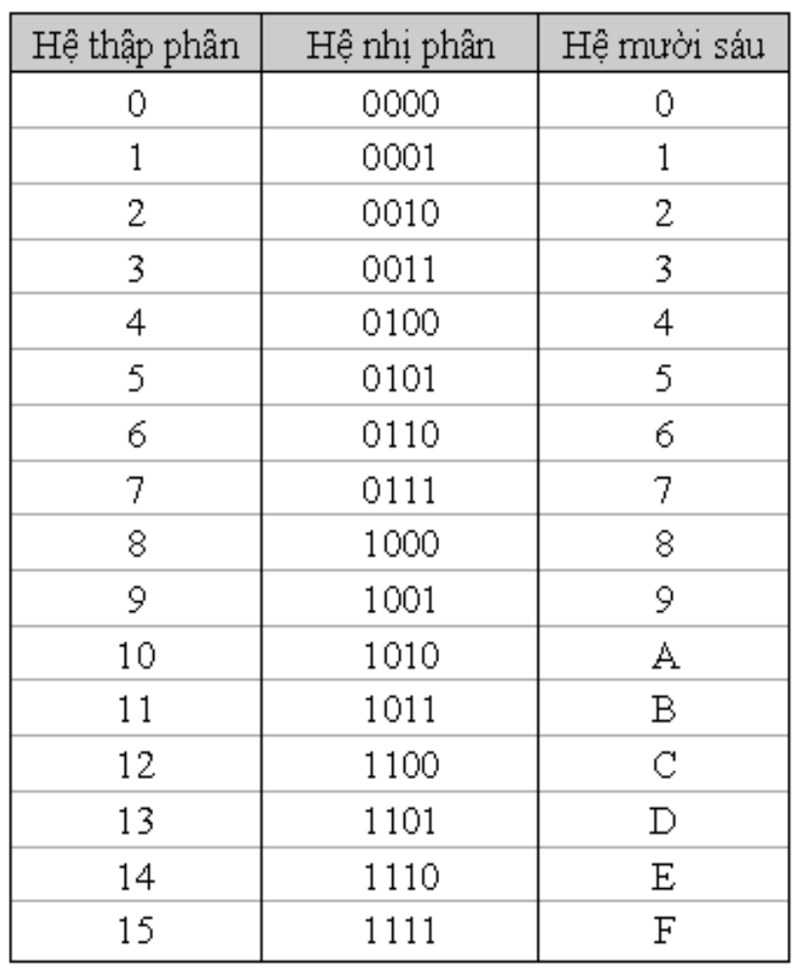
The hexadecimal system
Base b = 16
Using 16 digits and characters: 0,1,2,3,4,5,6,7,8,9,A,B,C,D,E,F
in which characters:
A, B, C, D, E, F
represent respected number in decimal system
10, 11, 12, 13, 14, 15.

Slide 21
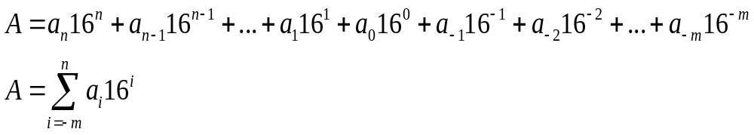
The hexadecimal system
Supposing that an A number which is represented in hexadecimal system as:
A = a_{n} a_{n-1} … a₁ a₀ . a₋₁ a₋₂ … a_{-m}
with a_{i} is digit in hexadecimal system, the value of A is determined as:

Slide 22
The hexadecimal system
E.g.: Determine value of 34F5C.12D₍₁₆₎ :
34F5C.12D₍₁₆₎ =
3x16⁴ + 4x16³ + 15x16² + 5x16¹ + 12x16⁰ +? = 216294(10) +?
?=1/16 + 2/16/16 +13/16/16/16=0.07348..

Slide 23
Convert a number from decimal system to other numeral system
In general a number N in the decimal system (N₍₁₀₎) consists of 2 part: Integer and Fraction.
Converting a number from decimal system to other numeral system including 2 steps:
  Convert integer part from decimal system to b-base system
  Convert fraction part from decimal system to b-base system

Slide 24
Convert a number from decimal system to other numeral system
Convert integer part:
  Step 1: Divide the integer part of N₍₁₀₎ by b, we obtain T₁, remainder is d_{1.}
  Step 2: if T₁ <> 0, Divide T₁ by b, we obtain T₂, remainder is d₂
  ….
  Step n: T_{n} = 0, remainder is d_{n} => stop
  Result number N(b) obtained by remainders in above steps as:
  N₍₁₀₎ = d_{n}d_{n-1}…d_{1 (b)}

Slide 25
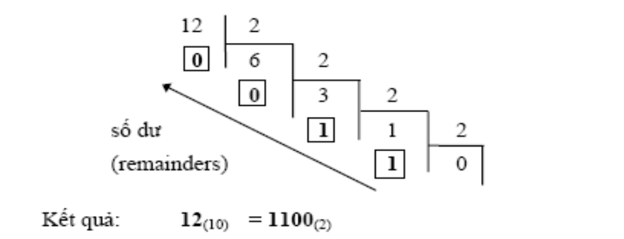
Convert a number from decimal system to other numeral system
  E.g.: Convert integer part of number 12.6875₍₁₀₎ to binary system:

Slide 26
Convert a number from decimal system to other numeral system
Convert fraction part of a number in decimal system to other system:
  Step 1: Multiple fraction part of N₍₁₀₎ with b, we obtain a number in form of x₁.y₁ (in which x in integer, y is fraction)
  Step 2: If y₁ <> 0, multipe 0.y₁ with b, we obtain x₂.y₂
  Step n: If y_{n-1} <> 0, multiple 0.y_{n-1} with b, we obtain x_{n}.0, => stop
  Result number is:
  0,x₁x₂…x_{n}

Slide 27
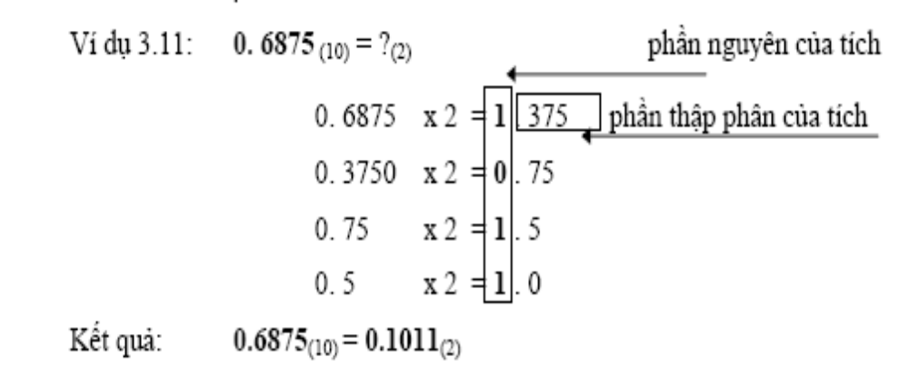
Convert a number from decimal system to other numeral system
  E.g.: Convert fraction part of number 12.6875₍₁₀₎ to binary system:

Slide 28
Examples
Decimal → Binary 124.75 = ?
Decimal → Binary 65.125 = ?
Binary → Hexa: 1011 1110 0110 = ?
Hexa → Binary: 3E8 = ?
Hexa → Decimal: 3A8C = ?

Slide 29
Represent data in computer
All data using in computer must be encoded into binary numbers
Data in computer is classified into 2 types:
  Basic data
  Structured data

Slide 30
Basic data
Integer
  Unsigned integer: Using binary.
  Signed integer: Using the 2's complement encoding.
Real:
  Using floating point number
Character:
  Using character encode: ASCII, Unicode, …

Slide 31
Structured data
Is a set of basic data which is structured in a specific manner.
E.g.: Array, string, record, …
Study more in other courses like Programming language.

Slide 32
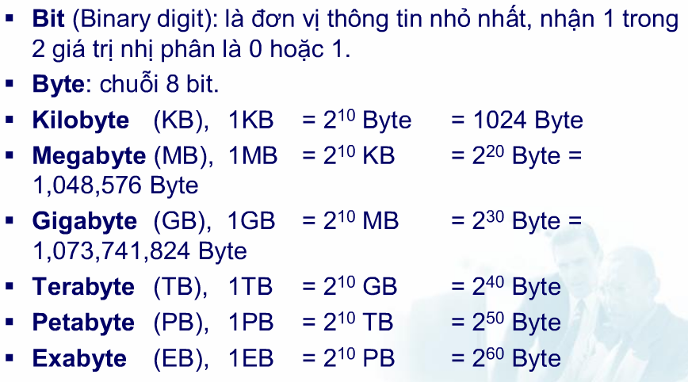
Information Unit

Slide 33
Represent data in computer
Representation of integer number
Representation of real number
Representation of character

Slide 34
Representation of integer number
Using a set of bits.
For signed integer, we use the first bit (Most significant bit) to represent “-” sign. We call this bit is signed bit.
Notes:
Số nguyên gồm số nguyên không dấu và số nguyên có dấu.

Slide 35
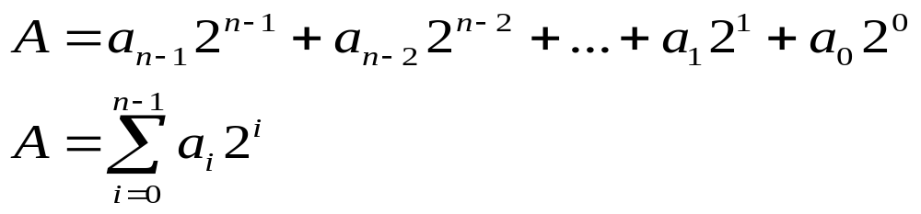
Representation of unsigned integer
Supposing that a number A is represented using n bits as:
a_{n-1}a_{n-2}...a₃a₂a₁a₀
then, value of A is determined as:
Using n bit to represent unsigned integer, we can represent values from 0 to 2^{n}-1

Slide 36
Examples
E.g. 1: Representing unsigned integer A and B numbers using 8 bits:
A = 45 B = 156
A = 45 = 32 + 8 + 4 + 1 = 2⁵ + 2³ + 2² + 2⁰
→ A = 0010 1101
B = 156 = 128 + 16 + 8 + 4 = 2⁷ + 2⁴ + 2³ + 2²
→ B = 1001 1100

Slide 37
Examples
E.g. 2: Given representation of unsigned integer numbers X and Y, determine values of X and Y:
X = 0010 1011
Y = 1001 0110
X = 0010 1011 = 2⁵ + 2³ + 2¹ + 2⁰
= 32 + 8 + 2 + 1 = 43
Y = 1001 0110 = 2⁷ + 2⁴ + 2² + 2¹
= 128 + 16 + 4 + 2 = 150

Slide 38
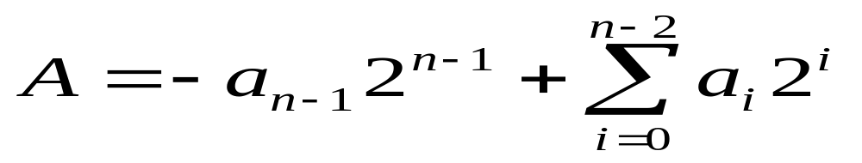
Representation of signed integer
Given representation of signed integer A as:
a_{n-1}a_{n-2}...a₂a₁a₀
then, value of A is determined as:
Using n bits, values of A is in: [-2^{n-1}, 2^{n-1}-1]
10000…000
……….
01111…111

Slide 39
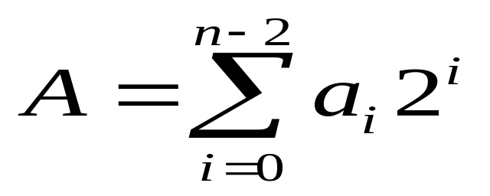
Representation of signed integer
Given representation of signed integer A as:
a_{n-1}a_{n-2}...a₂a₁a₀
If a_{n-1}:= 0:
    A is positive number
    a_{n-2}...a₂a₁a₀ represent value of A
    Values of A is in: [0, 2^{n-1}-1]

Slide 40
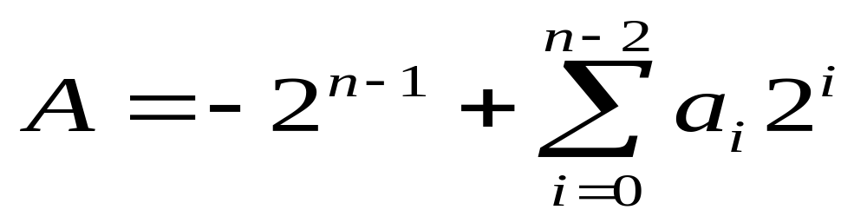
Representation of signed integer
Given representation of signed integer A as:
a_{n-1}a_{n-2}...a₂a₁a₀
If a_{n-1}:= 1:
    A is negative number
    Value of A is determined as:
  Values of A is in: [-2^{n-1}, -1]

Slide 41
Representation of signed integer
E.g.: Determine value of signed integers A and B:
A = 0101 0110
B = 1101 0010
A = 2⁶ + 2⁴ + 2² + 2¹ = 64 + 16 + 4 + 2 = +86
B = -2⁷ + 2⁶ + 2⁴ + 2¹ =
= -128 + 64 + 16 + 2 = -46

Slide 42
Representation of signed integer
Convert a signed integer number (+/-) from decimal system to binary system

Slide 43
Representation of signed integer
Using the 2’s complement encoding
Given an unsigned integer A which is represented in the binary system using n bits, then:
  The 1’s complement encoding of A = (2^{n} - 1) - A
  The 2’s complement encoding of A = 2^{n} – A
E.g.:
    given A = 0110
    The 1’s complement encoding of A = (2⁴ - 1) - 0110 = 1001
    The 2’s complement encoding of A = 2⁴ - 0110 = 1010

Slide 44
Representation of signed integer
A signed integer number –A is represented by the 2’s complement encoding of A
E.g.: Represent signed number A = -70 using 8 bits
A = 70 = 0100 0110
1’s comp.: 1011 1001
+ 1
2’s comp.: 1011 1010
Hence: -70 => 1011 1010

Slide 45
Operations on integer number
Plus/minus unsigned integer:
  Add/minus bit by bit from right side to left side.
Note:
  Sum of two unsigned integer n bits is also an unsigned integer n bits
  If sum is larger than 2^{n-1} then the result is wrong because of carry-out
Notes:
Trừ số không dấu thì ta chỉ trừ được số lớn cho số nhỏ. Trường hợp ngược lại sẽ sai

Slide 46
Examples
E.g. 1: plus two unsigned integer without carry-out
  X = 1001 0110 = 150
  Y = 0001 0011 = 19
  S = 1010 1001 = 169
  Carry-out = 0
E.g. 1: plus two unsigned integer with carry-out
  X = 1100 0101 = 197
  Y = 0100 0110 = 70
  S = 0000 1011 = 11 ≠ 267
  Carry-out = 1

Slide 47
Plus/minus signed integer
  Sum: plus bit by bit from right side to left side, remove remember bit if has.
  Minus:
    A – B = A + ( - B) = A + the 2’s complement encoding of B

Slide 48
Plus/minus signed integer
  Sum of two signed integers with opposite sign: Always return correct result
  Sum of two signed integers with same sign:
    If sign of Sum is the same as operands, then result is correct
    If not, result is wrong because of overflow
  Overflow is occurred if the result is out of range of representing integer using n bit:
  [-2^{n-1}, 2^{n-1}-1]

Slide 49
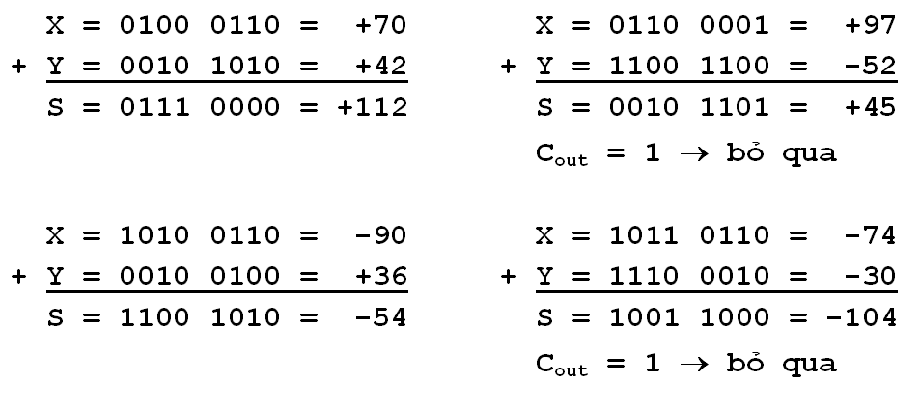
Examples
No overflow

Slide 50
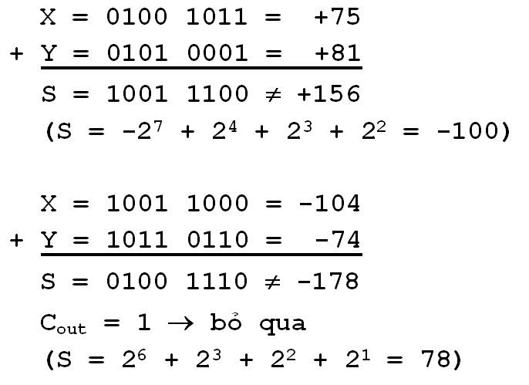
Examples
Overflow

Slide 51
Multiple/divide unsigned integer
Similar to as in decimal system.
E.g.: Multiple
  1011 ( = 11 in the 10 system)
  x
  1101 ( = 13 in the 10 system)
  -------------
  1011
  0000
  1011
  1011
  --------------
  10001111 ( = 143 in the 10 system)

Slide 52
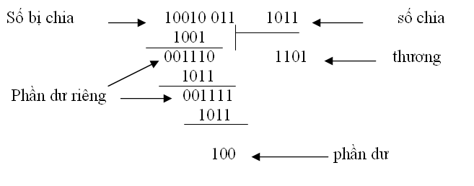
Multiple/divide unsigned integer
E.g.: Divide

Slide 53
Logic operations on a bit
 |  | AND | OR | XOR
0 | 0 | 0 | 0 | 0
0 | 1 | 0 | 1 | 1
1 | 0 | 0 | 1 | 1
1 | 1 | 1 | 1 | 0

Slide 54
Logic operations on a bit
 | NOT
0 | 1
1 | 0

Slide 55
Logic operations on a binary number
  Perform logic operations on each couple of bits of two operands
  These logic operands are only affect on that couple of bits, not on others.

Slide 56
Examples
VD: A = 1010 1010 và B = 0000 111
 | AND | OR | XOR | NOT
1010 1010 |  |  |  | 01010101
0000 1111 |  |  |  | 11110000
 | 00001010 | 10101111 | 10100101

Slide 57
Representation of Real number
General rule:
  In order to represent real number in computer, we use Floating point number

Slide 58
Representation of Real number
A floating point number has the form of:
X = M * R^{E}
in which:
  M is mantissa
  R is radix (base), usually be 2 or 10.
  E is exponent
Given R, to represent a real number X, we need to determine M and E (as integer number)

Slide 59
Representation of Real number
E.g.: Using R = 10, given two real numbers N1 and N2 represented in floating point with:
  M1 = -15 và E1 = +12
  M2 = +314 và E2 = -2
  Determine the values of N1 and N2?

Slide 60
Operations on floating point real number
Given two floating point real numbers:
  N1 = M1 x R^{E1} and N2 = M2 x R^{E2}
Add/Subtract:
N1 ± N2 = (M1 x R ^{E1-E2} ± M2) x R^{E2} ,
Multiple and divide
N1 x N2 = (M1x M2) x R ^{E1+E2}
N1 /N2 = (M1 / M2) / R ^{E1-E2}

Slide 61
IEEE 754/85 format
Is used to represent Floating point number
Radix R = 2
Consist of 3 types:
  Single precision, using 32-bit
  Double precision, using 64-bit
  Extended double precision, using 80-bit

Slide 62
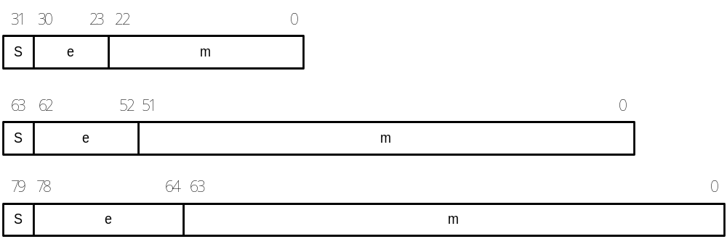
IEEE 754/85 format
Encoding format

Slide 63
IEEE 754/85 format
S is signed bit: S=0 for positive and and S=1 for negative number.
e is excess of exponent E: E = e – b
where b is bias:
  With 32-bit : b = 127, then E = e - 127
  With 64-bit : b = 1023, then E = e - 1023
  With 80-bit : b = 16383, then E = e – 16383
m is fraction part of M: M = 1.m

Slide 64
IEEE 754/85 format
S | e | m
Value of X is determined as follow:
X = (-1)^{S} x 1.m x 2^{e-b}

Slide 65
Example
E.g.1: Given X which is represented in IEEE 754 32 bit:
1100 0001 0101 0110 0000 0000 0000 0000
Determine value of X.
E.g.2: Given Y which is represented in IEEE 754 32 bit:
0011 1111 1000 0000 0000 0000 0000 0000
Determine value of Y.

Slide 66
Example
E.g. 3: Given a real number X = 6.375. Represent X in IEEE 754 using 32 bit

Slide 67
Note
If all bits of e are 0 and all bits of m are 0, then X = ± 0
If all bits of e are 1 and all bits of m are 0, then X = ± ∞
If all bits of e are 1 and at least one bit of m is 1, the X is not a number (NaN)

Slide 68
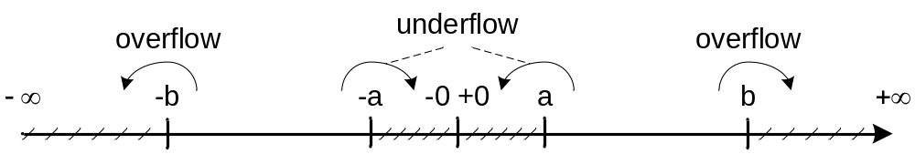
Representation range
32 bit: a = 2⁻¹²⁷ ≈ 10⁻³⁸ b = 2⁺¹²⁷ ≈ 10⁺³⁸
64 bit: a = 2⁻¹⁰²³ ≈ 10⁻³⁰⁸ b = 2⁺¹⁰²³ ≈ 10⁺³⁰⁸
80 bit: a = 2⁻¹⁶³⁸³ ≈ 10⁻⁴⁹³² b = 2⁺¹⁶³⁸³ ≈ 10⁺⁴⁹³²

Slide 69
Operations of IEEE
X1 = M1 * R^{E1}
X2 = M2 * R^{E2}
Ta có
  X1 ± X2 = (M1 * R^{E1-E2} ± M2) * R^{E2} , với E1 ≥ E2
  X1 * X2 = (M1 * M2) * R^{E1+E2}
  X1 / X2 = (M1 / M2) * R^{E1-E2}

Slide 70
Representation of characters
General rule:
  Convert characters to binary.
  The number of bits used to encode each character depend on encoding set.
  E.g. :
    ASCII uses 8 bits
    Unicode uses 16 bits.
Notes:
Ascii và Unicode là hai bộ mã đang được dùng phổ biến nhất hiện nay.

Slide 71
ASCII
Proposed by ANSI (American National Standard Institute)
ASCII uses 8 bit, hence it can represent 256 characters
Character has code in range: 00₁₆ ÷ FF₁₆

Slide 72
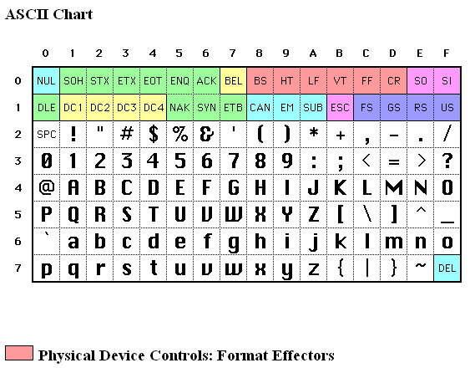

Slide 73
ASCII
95 displayable characters has code:20₁₆ ÷ 7E_{16,} in which:
  'A' ÷ 'Z' has code: 41₁₆ ÷ 5A₁₆
  'a' ÷ 'z' has code: 61₁₆ ÷ 7A₁₆
  '0' ÷ '9' has code: 30₁₆ ÷ 39₁₆

Slide 74
ASCII
33 control characters has code: 00₁₆ ÷ 1F₁₆ and code 7F₁₆ is used for control function

Slide 75
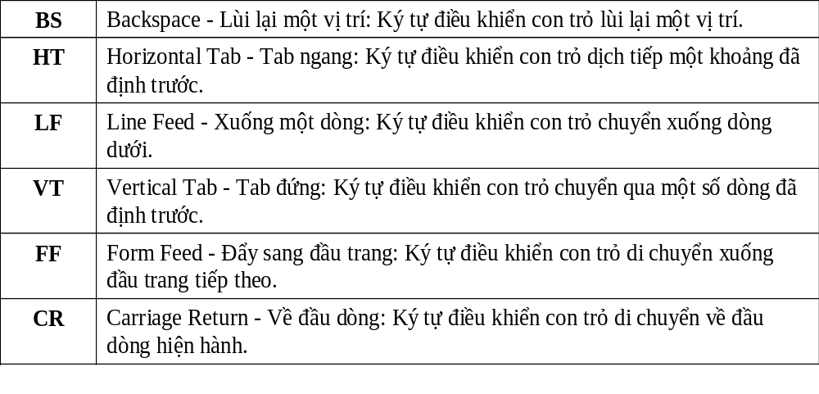
Format control

Slide 76
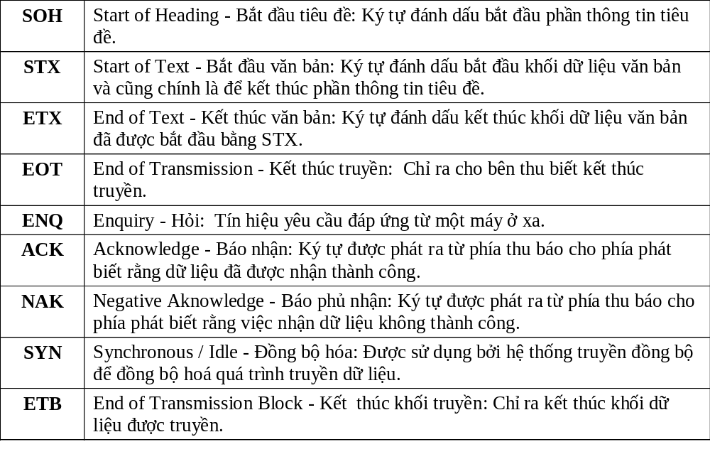
Data transfer control

Slide 77
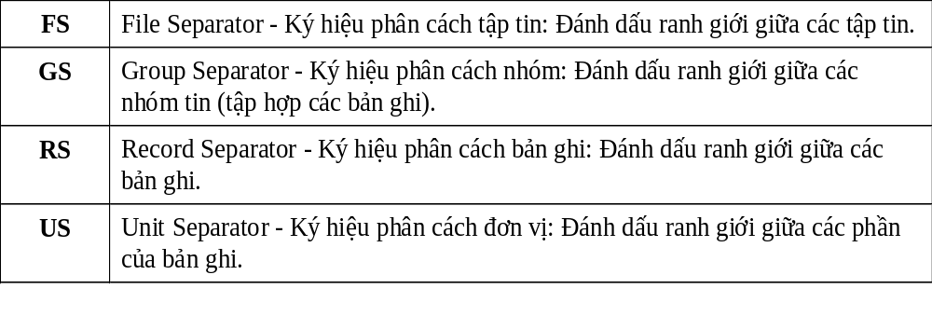
Separate information control

Slide 78
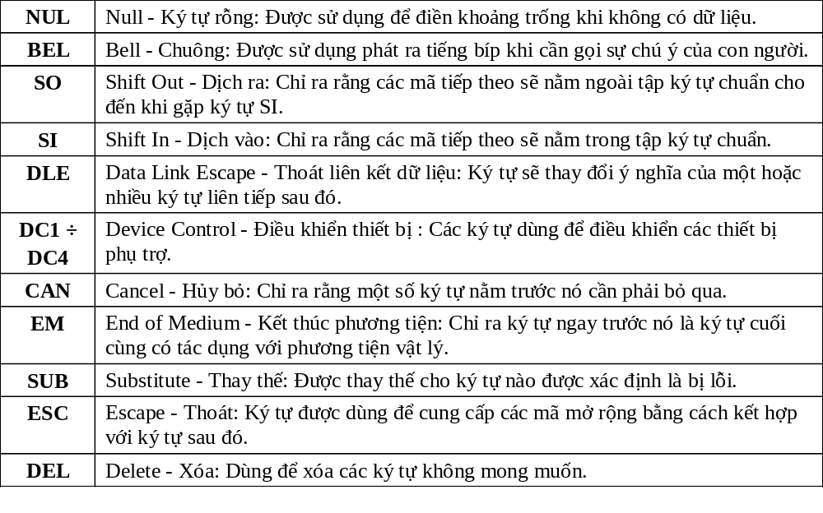
Other controls

